Slide 1
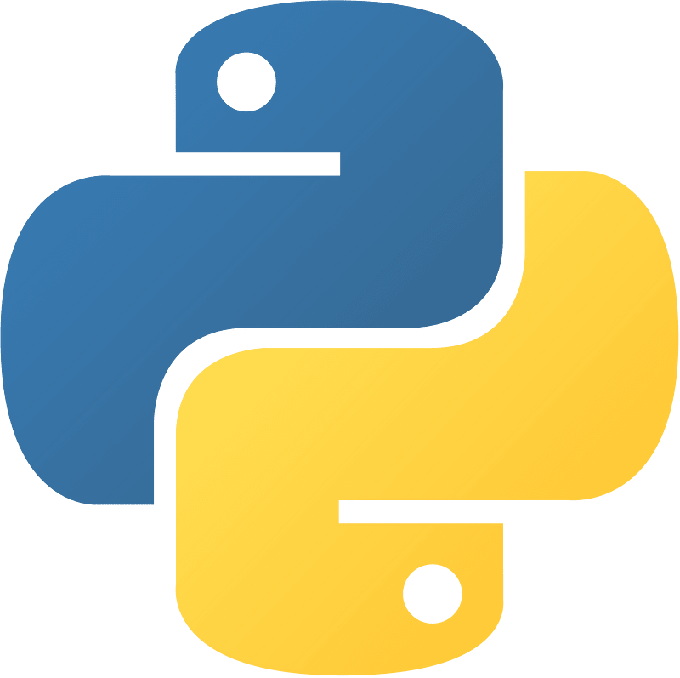

Advanced Python Programming
By: Faisal Zamir
Chapter 06 Advanced Input and Output Operations
Introduction to input and output operations
Reading (Input) and writing (Output)
Reading CSV file and Writing to it
Reading Excel file and Writing to it
Reading JSON file and Writing to it
Advanced Python

Slide 2
Advanced Python Programming
By: Faisal Zamir
Chapter 06 Advanced Input and Output Operations
Input (Reading) : Getting data from user (file)
Output (Writing) : Showing result to user (file)
Advanced Python

Slide 3
Advanced Python Programming
By: Faisal Zamir
Chapter 06 Advanced Input and Output Operations
To work with different files like CSV, Excel and JSON file, you can use different libraries.
I will use Pandas Library to work with these files for I/O operations
To install Pandas
pip install pandas
To learn complete Pandas, I provide a complete course.
Advanced Python

Slide 4
Advanced Python Programming
By: Faisal Zamir
Chapter 06 Advanced Input and Output Operations
Reading CSV files: You can read a CSV file into a DataFrame using the read_csv() method.
For example, pd.read_csv('file.csv').
Advanced Python

Slide 5
Advanced Python Programming
By: Faisal Zamir
Chapter 06 Advanced Input and Output Operations
Example:
import pandas as pd
df = pd.read_csv('sample_data.csv')
print("First 5 rows:", df.head())
print("Column names:", df.columns)
print("Data types:", df.dtypes)
print("Summary statistics:", df.describe())
Advanced Python

Slide 6
Advanced Python Programming
By: Faisal Zamir
Chapter 06 Advanced Input and Output Operations
Writing CSV files: You can write a DataFrame to a CSV file using the to_csv() method. For example, df.to_csv('file.csv').
Advanced Python

Slide 7
Advanced Python Programming
By: Faisal Zamir
Chapter 06 Advanced Input and Output Operations
Example:
import pandas as pd
data = { 'Name': ['Alia', 'Bob', 'Charlie', 'David'],
'Age': [25, 30, 35, 40],
'Country': ['USA', 'Canada', 'France', 'Australia'] }
df = pd.DataFrame(data)
# Write the DataFrame to a CSV file
df.to_csv('output.csv', index=False)
Advanced Python

Slide 8
Advanced Python Programming
By: Faisal Zamir
Chapter 06 Advanced Input and Output Operations
Reading Excel files: You can read an Excel file into a DataFrame using the read_excel() method.
For example, pd.read_excel('file.xlsx').
Advanced Python

Slide 9
Advanced Python Programming
By: Faisal Zamir
Chapter 06 Advanced Input and Output Operations
Example:
import pandas as pd
df = pd.read_excel('sample_data.xlsx', sheet_name='Sheet1')
print("First 5 rows:", df.head())
print("Column names:", df.columns)
print("Data types:", df.dtypes)
print("Summary statistics:\n", df.describe())
Advanced Python

Slide 10
Advanced Python Programming
By: Faisal Zamir
Chapter 06 Advanced Input and Output Operations
Writing Excel files: You can write a DataFrame to an Excel file using the to_excel() method. For example, df.to_excel('file.xlsx').
Advanced Python

Slide 11
Advanced Python Programming
By: Faisal Zamir
Chapter 06 Advanced Input and Output Operations
Example:
import pandas as pd
data = { 'Name': ['Alia', 'Bob', 'Charlie', 'David'],
'Age': [25, 30, 35, 40],
'Country': ['USA', 'Canada', 'France', 'Australia'] }
df = pd.DataFrame(data)
# Write the DataFrame to an Excel file
writer = pd.ExcelWriter('output.xlsx')
df.to_excel(writer, index=False)
writer.save()
Advanced Python

Slide 12
Advanced Python Programming
By: Faisal Zamir
Chapter 06 Advanced Input and Output Operations
What is JSON File?
JSON (JavaScript Object Notation) is a lightweight data interchange format that is easy for humans to read and write and easy for machines to parse and generate.
Example:
{
"name": "John Doe",
"age": 30,
"city": "New York"
}
Advanced Python

Slide 13
Advanced Python Programming
By: Faisal Zamir
Chapter 06 Advanced Input and Output Operations
Reading JSON files: You can read a JSON file into a DataFrame using the read_json() method.
For example, pd.read_json('file.json').
Advanced Python

Slide 14
Advanced Python Programming
By: Faisal Zamir
Chapter 06 Advanced Input and Output Operations
Example:
import pandas as pd
with open('sample_data.json', 'r') as file:
data = file.read()
df = pd.read_json(data)
print("First 5 rows:\n", df.head())
print("Column names:", df.columns)
print("Data types:", df.dtypes)
Advanced Python

Slide 15
Advanced Python Programming
By: Faisal Zamir
Chapter 06 Advanced Input and Output Operations
Writing JSON files: You can write a DataFrame to a JSON file using the to_json() method. For example, df.to_json('file.json').
Advanced Python

Slide 16
Advanced Python Programming
By: Faisal Zamir
Chapter 06 Advanced Input and Output Operations
Example:
import pandas as pd
data = { 'Name': ['Alice', 'Bob', 'Charlie', 'David'],
'Age': [25, 30, 35, 40],
'Country': ['USA', 'Canada', 'France', 'Australia'] }
df = pd.DataFrame(data)
df.to_json('output.json', orient='records')
Advanced Python

